Slide 1
Sponsored Search Auctions

Slide 2
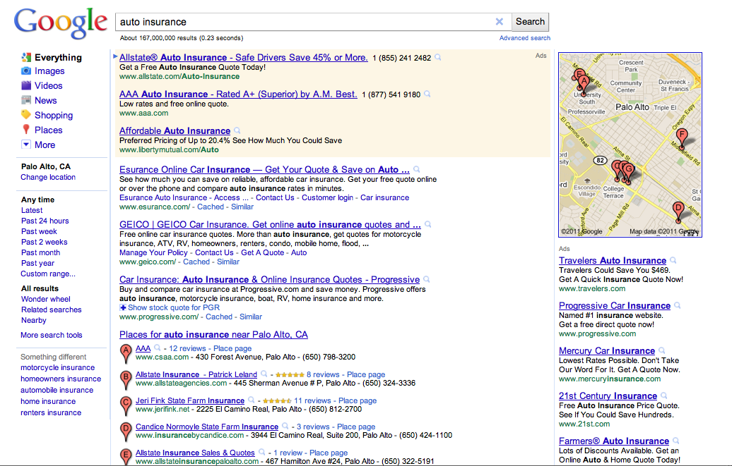
Traffic estimator

Slide 3
Sponsored Search Auctions
Search advertising is a huge auction market
  Google ad revenue in 2013: $50.5 billion.
  Hal Varian, Google Chief Economist “Most people don’t realize that all that money comes pennies at a time.”
Why would you use auctions in this setting?
  Difficult to set so many prices (tens of millions of keywords)
  Demand and especially supply might be changing.
  Retain some price-setting ability via auction design
Today: theory and practice of these auctions
  An application of the assignment market model!

Slide 4
Keyword Auctions
Advertisers submit bids for keywords
  Offer a dollar payment per click.
  Alternatives: price per impression, or per conversion.
Separate auction for every query
  Positions awarded in order of bid (more on this later).
  Google uses “generalized second price” auction format.
  Advertisers pay bid of the advertiser in the position below.
Some important features
  Value is created by getting a good match of ad to searcher.
  Multiple positions, but advertisers submit only a single bid.

Slide 5
Brief History
Mid-1990s: Overture (GoTo) allows advertisers to bid for keywords, offering to pay per click. Yahoo! and others adopt this approach, charging advertisers their bids.
Auction design becomes more sophisticated; auctions used to allocate advertising on many webpages, not just search.
1990s: websites sell advertising space on a “per-eyeball” basis, with contracts negotiated by salespeople; similar to print or television.
2000s: Google and Overture modify keyword auction to have advertisers pay minimum amount necessary to maintain their position (GSP).

Slide 6
Assignment Model
Positions k = 1,…,K
Bidders n = 1,…,N
Position k gets x_{k} clicks per day: x₁ > x₂ > … > x_{K}
Bidder n has value v_{n} per click: v₁ > v₂ > … > v_{N.}
Bidder n’s value for position k is: v_{n}* x_{k}.
Bidder n’s profit if buys k, pays p_{k} per click: (v_{n}-p_{k})*x_{k}.
Efficient, or surplus maximizing, assignment is to give position 1 to bidder 1, position 2 to bidder 2, etc.

Slide 7
Example
Two positions: receive 200 and 100 clicks per day
Bidders 1,2,3 have per-click values $10, $4, $2.
 | Top | 2nd
Bidder 1 | 2000 | 1000
Bidder 2 | 800 | 400
Bidder 3 | 400 | 200
Efficient allocation creates value $2400
  Bidder 1 gets top position: value 200*10 = 2000
  Bidder 2 gets 2nd position: value 100*4 = 400

Slide 8
Market Clearing Prices
Solve for the market clearing “per-position” prices
 | Top | 2nd
Bidder 1 | 2000 | 1000
Bidder 2 | 800 | 400
Bidder 3 | 400 | 200
Lowest market clearing prices: 600 and 200
  Bidder 1 prefers top position
  Bidder 2 prefers 2nd position
  Bidder 3 demands nothing.

Slide 9
“Per Click” Prices
Market clearing position prices are 600 and 200.
Positions receive 200 and 100 clicks per day
This equates to $3 and $2 per click for the two positions.
Check: per-click prices p₁ = 3, p₂ = 2 clear the market
  Bidder 3 wants nothing: value is only $2 / click.
  Bidder 2 wants position 2: 100*(4-2) >= 200*(4-3)
  Bidder 1 wants position 1: 200*(10-3) > 100*(10-2)
Efficient outcome with revenue: $600+$200= $800

Slide 10
Find All Market-Clearing Prices
Positions get 200 and 100 clicks.
Bidder per click values 10, 4, 2.
Bidder 3 demands nothing: p₁ ≥ 2 and p₂ ≥ 2
Bidder 2 demands position 2: p₂ ≤ 4 and 2p₁ ≥ 4+p₂
  Prefers 2 to nothing: 100*(4-p₂) ≥ 0
  Prefers 2 to 1: 200*(4- p₁) ≤ 100*(4- p₂)
Bidder 1 demands position 1: 2p₁ ≤ 10 + p₂
  Prefers 1 to nothing: 200*(10-p₁) ≥ 0 (redundant)
  Prefers 1 to 2: 200*(10 - p₁) ≤ 100*(10 - p₂)

Slide 11
Market Clearing Prices
p₁
Revenue = 200p₁ + 100p₂
8
6
p₁ ≥ 2+(1/2)p₂
p₁ ≤ 5+(1/2)p₂
4
2
2 ≤ p₂ ≤ 4
Note that p₁ ≥ p₂
2
4
p₂

Slide 12
Price Premium for More Clicks
At market clearing prices, bidder k wants to buy k
Therefore bidder k prefers position k to position k-1
(v_{k}- p_{k})*x_{k} ≥ (v_{k} – p_{k-1})*x_{k-1}
We know that v_{k}≥p_{k} and also that x_{k-1}≥x_{k.}
Therefore, it must be the case that p_{k-1}≥ p_{k}.
Per-click prices must be higher for better positions

Slide 13
Finding Market Clearing Prices
Suppose more bidders than positions, so N>K.
Set p_{K} so that bidder K+1 won’t buy: p_{K} = v_{K+1}
Set p_{k} so that bidder k+1 will be just indifferent between position k+1 and buying up to position k:
(v_{k+1} – p_{k})*x_{k} = (v_{k+1} – p_{k+1})*x_{k+1}
This works as an algorithm to find lowest clearing prices.
To find highest market clearing prices, set p_{K}=v_{K} and set p_{k} so that bidder k is just indifferent between k and k+1.

Slide 14
Sponsored Search Auctions
Can we design an auction to find market clearing prices?
The auctions we studied before for the assignment market require relatively complex bids (each bidder must bid separately for each of the K positions or items).
Ideally want to use the structure of the problem to design a simpler auction. We’ll consider several options.

Slide 15
Pay-As-Bid Auction
Overture “Pay-as-Bid” Auction
  Each bidder submits a single bid (in $ per click)
  Top bid gets position 1, second bid position 2, etc.
  Bidders pay their bid for each click they get.

Slide 16
Example: Pay-as-Bid
Two positions: receive 200 and 100 clicks per day
Bidders 1,2,3 have per-click values $10, $4, $2.
Overture auction (pay as bid)
  Bidder 3 will offer up to $2 per click
  Bidder 2 has to bid $2.01 to get second slot
  Bidder 1 wants to bid $2.02 to get top slot.
  But then bidder 2 wants to top this, and so on.
Pay as bid auction is unstable!

Slide 17
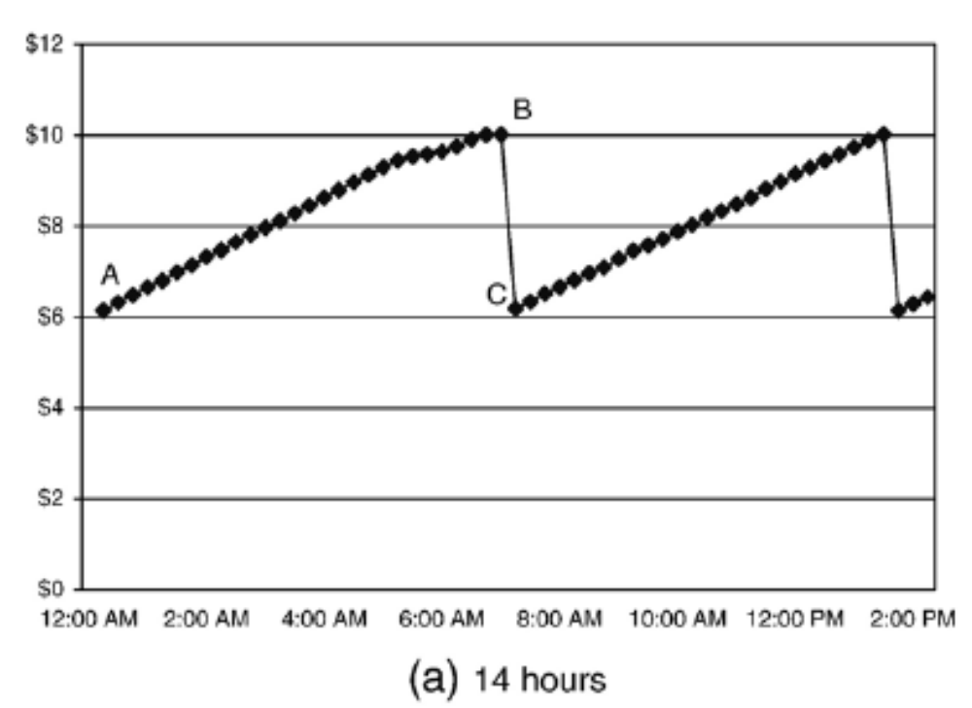
Overture bid patterns
Edelman & Ostrovsky (2006): “sawtooth” pattern caused by auto-bidding programs.

Slide 18
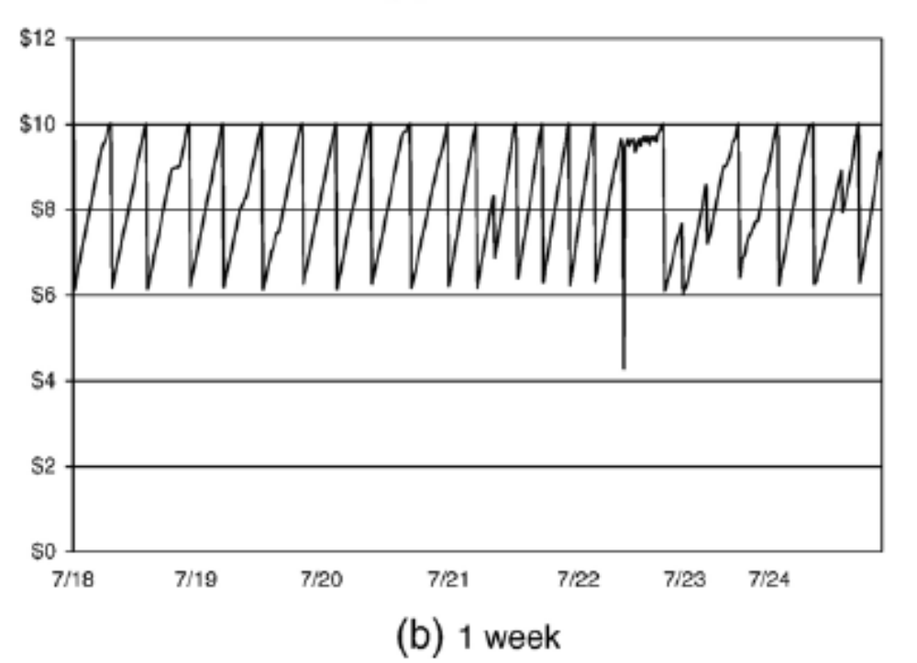
Overture bid patterns, cont.

Slide 19
Google “GSP” Auction
Generalized Second Price Auction
  Bidders submit bids (in $ per click)
  Top bid gets slot 1, second bid gets slot 2, etc.
  Each bidder pays the bid of the bidder below him.
Seems intuitively like a more stable auction.
Do the bidders want to bid truthfully?

Slide 20
Truthful bidding?
Not a dominant strategy to bid “truthfully”!
Example: two positions, with 200 and 100 clicks.
Consider bidder with value 10
Suppose competing bids are 4 and 8.
  Bidding 10 wins top slot, pay 8: profit 200 • 2 = 400.
  Bidding 5 wins next slot, pay 4: profit 100 • 6 = 600.
If competing bids are 6 and 8, better to bid 10…

Slide 21
Example: GSP auction
Recall bidder values 10, 4, 2, and clicks 200 and 100.
In this example, it is a Nash equilibrium to bid truthfully.
Verifying the Nash equilibrium with bids 10, 4, 2.
  Bidder 3 would have to pay $4 to get slot 2 – not worth it.
  Bidder 2 is willing to pay $2 per click for position 2, but would have to pay $10 per click to get position 1 – not worth it.
  Bidder 1 could bid below $4 and pay $2 for the lower slot, rather than $4 for the top, but wouldn’t be profitable.
Prices paid per click in this NE are 4 and 2.
Payments are 200*4 + 100*2 = 1000.

Slide 22
GSP equilibrium prices
p₁
GSP prices are
also competitive
equilibrium prices!
8
6
GSP eqm
4
Not the only GSP
equilibrium, however
2
2
4
p₂

Slide 23
Example: GSP auction
Recall bidder values 10, 4, 2, and clicks 200 and 100.
Another Nash equilibrium of the GSP (w/ higher prices)
Bidder 1 bids $6, Bidder 2 bids $5, Bidder 3 bids $3.
Verifying the Nash equilibrium
  Bidder 3 doesn’t want to pay $5 or more to buy clicks
  Bidder 2 is willing to pay $3 per click for the second position but doesn’t want to pay $6 per click for position 1.
  Bidder 1 prefers to pay $5 for top position rather than $3 for bottom position because 200*(10-5) > 100*(10-1).
Prices in this equilibrium are $5 and $3.

Slide 24
Example: GSP auction
Recall bidder values 10, 4, 2, and clicks 200 and 100.
Yet another GSP equilibrium – w/ lowest clearing prices!
Bidder 1 bids $10, Bidder 2 bids $3, Bidder 3 bids $2
Verifying the Nash equilibrium
  Bidder 3 doesn’t want to pay $3 or more for clicks
  Bidder 2 doesn’t want to pay $10 per click to move up.
  Bidder 1 pays $3 for top position, better than $2 for bottom because profits are 200*(10-3) > 100*(10-2).
In this equilibrium, per-click prices are $3 and $2.

Slide 25
GSP equilibrium prices
p₁
Claim: For every competitive equilibrium there is a corresponding GSP equilibrium.
8
6
GSP eqm
GSP eqm
4
2
2
4
p₂

Slide 26
Finding GSP Equilibria
Fix a set of market clearing per-click prices: p₁,…,p_{N}
There is a corresponding GSP equilibrium in which:
  Bidder 1 can bid anything
  Bidder 2 bids p₁
  Bidder 3 bids p₂
  Etc.
Bidder k will prefer to buy position k and pay p_{k} rather than buying position m and paying p_{m} --- that’s why the prices were market clearing!
Note: we’re assuming here that N>K (enough bidders).

Slide 27
Vickrey Auction
Bidders submit bids ($ per-click)
Seller finds assignment that maximizes total value
  Puts highest bidder in top position, next in 2nd slot, etc.
Charges each winner the total value their bid displaces.
  For bidder n, each bidder below n is displaced by one position, so must add up the value of all these “lost” clicks.
Facebook uses a Vickrey auction.
Dominant strategy to bid one’s true value.

Slide 28
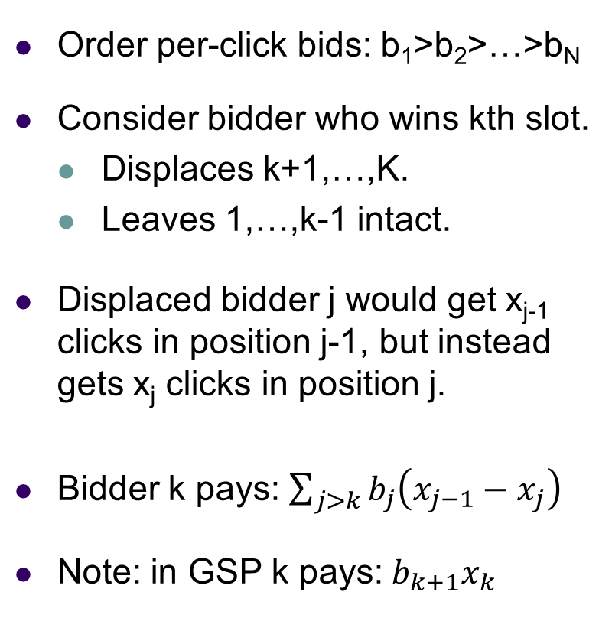
Vickrey Auction Pricing
Order per-click bids: b₁>b₂>…>b_{N}
Consider bidder who wins kth slot.
  Displaces k+1,…,K.
  Leaves 1,…,k-1 intact.
Displaced bidder j would get x_{j-1} clicks in position j-1, but instead gets x_{j} clicks in position j.
Bidder k pays: $\sum_{j>k}{b_{j}\left(x_{j−1}−x_{j}\right)}$
Note: in GSP k pays:$b_{k+1}x_{k}$
Position | With bidder k | No Bidder k
1 | b₁ | b₁
2 | b₂ | b₂
… | … | …
k-1 | b_{k-1} | b_{k-1}
k | b_{k} | b_{k+1}
k+1 | b_{k+1} | b_{k+2}
… | … | …
K | b_{K} | b_{K+1}

Slide 29
Vickrey Auction Example
Recall bidder values 10, 4, 2, and clicks 200 and 100.
Vickrey payment for Bidder 2
  Bidder 2 displaces 3 from slot 2
  Value lost from displacing 3: $2 * 100 = $200
  So Bidder 2 must pay $200 (for 100 clicks), or $2 per click.
Vickrey payment for Bidder 1
  Displaces 3 from slot 2: must pay $200
  Displaces 2 from slot 1 to 2: must pay $4*(200-100)=$400
  So Bidder 1 must pay $600 (for 200 clicks), or $3 per click.
Vickrey “prices” are p₂ = 2 and p₁ = 3, revenue $800.

Slide 30
Vickrey prices
p₁
Vickrey prices are
the lowest competitive
equilibrium prices!
8
6
4
2
Vickrey prices
Revenue = 200*3+100*2=800
2
4
p₂

Slide 31
Summary of Auction Results
Result 1. The generalized second price auction (GSP) does not have a dominant strategy to bid truthfully.
Result 2. The Nash Equilibria of the GSP are “equivalent” to the set of competitive equilibria*:
  Bidders obtain their surplus-maximizing positions
  For any NE of the GSP, the prices paid correspond to market clearing prices, and for any set of market clearing prices, there is a corresponding NE of GSP.
Result 3. The Vickrey auction does have a dominant strategy to bid truthfully, and the payments correspond to the lowest market-clearing position payments.
*Small caveat here: there are also some “weird” NE of the GSP that I’m ignoring.

Slide 32
Keyword Auction Design
Platforms do retain some control over prices
  Restricting the number of slots can increase prices.
  Setting a reserve price can increase prices
Platforms can also “quality-adjust” bids
  In practice, ads that are more “clickable” get promoted.
  Bids can be ranked according to bid * quality.
  This gives an advantage to high-quality advertisements.

Slide 33
Example: Reserve Prices
Two positions with 200, 100 clicks
Three bidders with values $2, $1, $1
Baseline: focus on lowest market clearing prices
  Bottom position sells for $1 / click => revenue $100
  Top position sells for $1 / click => revenue $200.
Can the seller benefit from a reserve price?
  No reserve price: revenue of $300.
  Reserve price of $2: revenue of $400
    Sell only one position, but for $2 per click!
Notes:
33

Slide 34
Quality Scoring
Suppose that instead of any bidder getting x_{k} clicks in position k, bidder n can expect to get a_{n}*x_{k} clicks.
If a bidder has a high a_{n}, its ad is “clickable”.
In practice, Google and Bing run giant regressions to try to estimate the “clickability” of different ads.
Then bids in the auction can be ranked by a_{n}*b_{n}, which means that clickable ads get prioritized in the rankings.
This can have advantages and disadvantages
  Puts weight on what users want and rewards higher quality ads.
  Sometimes can reduce revenue if one ad gets lots of clicks.

Slide 35
Sponsored vs organic results
Google and Bing show “organic” search results on the left side of the page and “sponsored” results on the right.
The assignment of positions on the page is different
  Organic search results: use algorithm to assess “relevance”
  Sponsored search results: use bids to assess “value”
To some extent there is competition
  If a site gets a good organic position, should it pay for another?
  Search engines have to think about maximizing user experience but also about capturing revenue from advertisers … tricky.

Slide 36
Sponsored Search Summary
Search auctions create a real-time market in which advertising opportunities are allocated to bidders.
Auction theory suggests why the “second-price” rules used in practice might be reasonably efficient.
  GSP does not induce “truthful” bidding but it has efficient Nash equilibria with competitive prices.
  Vickrey auction does induce truthful bidding, but prices depend on a more complicated formula.
In practice, the search platforms have a fair amount of scope to engage in optimal auction design.

